Slide 1

A101 Science
Problem 05: Marvellous Molecule
6th Presentation
Copyright © 2010

Slide 2
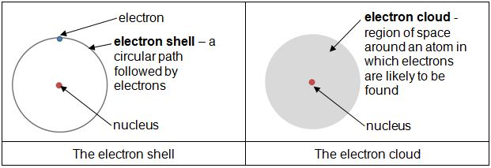
Atomic Structure
Atoms are traditionally thought to be positive nuclei, each surrounded by “shells” of negative electrons.
In fact, electrons do not move in a fixed pattern. Instead they move randomly in a fixed region.
Hence, atoms are more accurately described as positive nuclei, each surrounded by a “cloud” of negative electrons.

Slide 3
Non-polar bonds: Equal sharing of bonding electrons
When two atoms of similar electronegativity bond together, the bonding electrons are more or less equally shared.
Nucleus of atom A
Bonding electrons
Nucleus of atom B
Electronegativity of A ≈ Electronegativity of B
Note: Shared electrons are also in constant motion. The diagram above represents only their average position.
The electron cloud around the molecule is evenly distributed on the average.
This means that there are no permanent charges on the molecule. Each end of the bond has an equal chance of developing temporary partial charges at any time.
Notes:
Facilitators to elaborate on the note in the diagram.

Slide 4
Non-polar bonds: Equal chance of each kind of electron cloud distribution
Due to the electrons’ random movement, most of them could
  gather on one side of
  a molecule at an instant,
  and in the next instant,
  gather on the opposite side
Partially negative
Partially positive
  Or end up
  evenly distributed
Whenever the electrons gather more to one side,
partial charges are produced on the molecule.

Slide 5
Interactions due to temporary partial charges
These partial charges give rise to temporary dipole interactions between nearby molecules.
Repel
No effect
Repel
Attract
Repel
Attract
No effect
Attract

Slide 6
Unequal sharing of bonding electrons
In most molecules, atoms of two different elements are bonded together.
Since different atoms have different electronegativities (strength of attraction for bonding electrons), the bonding electrons may be more attracted to one nucleus.
Nucleus of atom A
Bonding electrons
Nucleus of atom B
Electronegativity of A > Electronegativity of B

Slide 7
Effect of electronegativity on electron cloud distribution.
The electrons in the electron cloud would also be more likely to gather around the atom with higher electronegativity.
Atom A
Atom B
Electron cloud distribution
when Electronegativity of A > Electronegativity of B

Slide 8
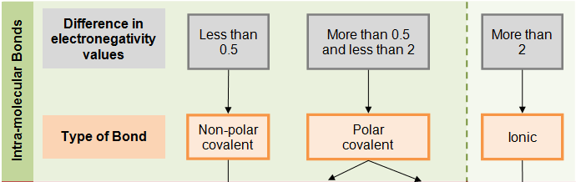
Electronegativity and the type of bonds within molecules
Unlike the movement of electrons, the electronegativity value of an atom is fixed and permanent.
The type of bonds formed between atoms and resulting charges across the molecule depend on the atoms’ electronegativity values, as shown below.
Notes:
Facilitator can emphasize:
Because the electronegativity values are fixed (i.e. the difference in strengths of the two different nuclei is always the same), the charges arised from a polar bond is permanent.
Ionic compounds are not molecules and the charges are on ions.

Slide 9
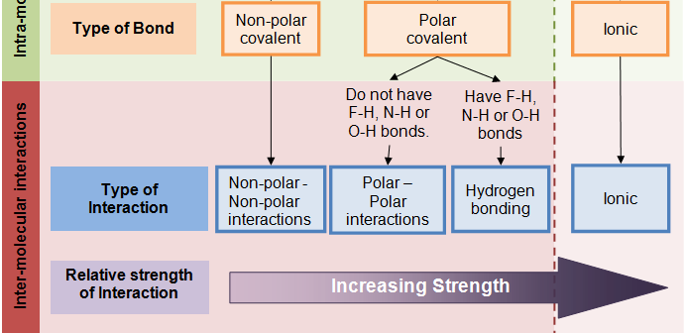
Types of intermolecular interactions
The charges across the molecule would then affect the strength of inter-molecular interactions.

Slide 10
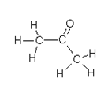
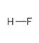
Hydrogen Bonding
Hydrogen bonding is a special type of polar – polar interaction between polar molecules.
It is stronger than other types of polar interactions.
It occurs between molecules when one molecule has a H-F, H-N or H-O bond, and the other has a polar bond involving F, N or O.
Hydrogen bonding

Slide 11
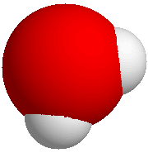
Unequal sharing of bonding electrons within a water molecule
The water molecule, H₂O
Partial positive
H
O
H
Partial negative
Partial positive
The oxygen nucleus has a higher electronegativity than the hydrogen nuclei. Hence the shared pairs of electrons are generally found to be closer to the oxygen nucleus, causing the O-H bond to be polar.
The electron cloud tends to gather around the O atom, resulting in a permenant, partially negative charged region at the oxygen end and a permenant partially positive charged region at each hydrogen end.

Slide 12
Interactions between charged molecules and charged objects
Since water molecules have charged regions, they will orientate themselves and be attracted to charged objects.
Partial positive
-
-
-
-
-
-
-
-
Partial positive
+
+
+
+
+
+
+
H
H
Partial negative
Partial negative
O
H
O
H
Partial positive
Partial positive
Negatively charged object
Positively charged object
After orientating themselves, they will move towards the charged object due to the attraction between opposite charges.
Notes:
Shift position of water molecule

Slide 13
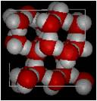
Structure of Ice
In the same way, when water molecules are forced to remain at their positions in solid form, the oppositely charged regions will attract and orientate towards each other, resulting in a regular structure.

Slide 14
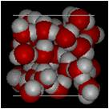
Structure of Ice
Compared to the structure of liquid water, in which water molecules are constantly moving, there is much more space between water molecules in ice.
This results in few molecules per unit volume, and hence a lower density.
Liquid
Solid
Notice the empty spaces within the solid (ice) structure.
Upon cooling, water contracts until it reaches 4ºC then it expands until it is a solid.

Slide 15
Boiling Point
When substances boil, the inter-molecular interactions between substances are broken. As a result, the boiling point of a substance depends on the strength of intermolecular interactions between molecules.
Since water molecules contain O-H bonds, there is hydrogen bonding between water molecules, which is the strongest kind of intermolecular interaction. Thus, water has the highest boiling point when compared with H₂S and Cl₂O.

Slide 16
Learning points
Electrons move randomly in a region of space around the nucleus. This region is the electron cloud.
Random movement of electrons result in temporary charges around a molecule. Temporary non-polar – non-polar interactions occur between such molecules.
When bonded atoms have significantly different electronegativities, the bond becomes polar. This results in permanent charges and polar-polar interactions to occur between such molecules.
The strongest kind of polar-polar interactions is Hydrogen bonding, which occurs between molecules with O-H, F-H and N-H bonds.
Boiling points are determined by the strength of intermolecular interactions. The weakest interactions are generally
non-polar – non-polar interactions, followed by polar – polar interactions and finally hydrogen bonding.

Slide 17
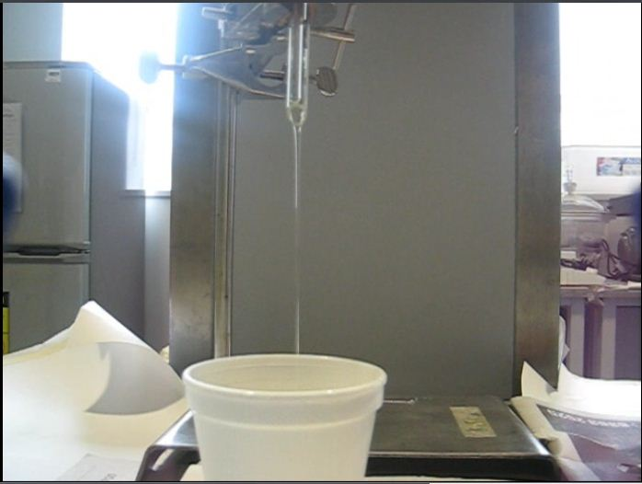
Discussion
Let’s watch what happens when the same object, charged the same way, is placed near a stream of oil.
Explain why oil behaves differently from water when placed near a charged object.

